Slide 1

Building a User Driven GEOSS
Masami Onoda, GEO Secretariat
Workshop at 34th ISRSE, Sydney, Australia
10 April, 2011

Slide 2
Who are GEOSS Users?
Why do we engage them?
How do we engage them?
U.S. Department of State, Washington DC
July 31, 2003

Slide 3
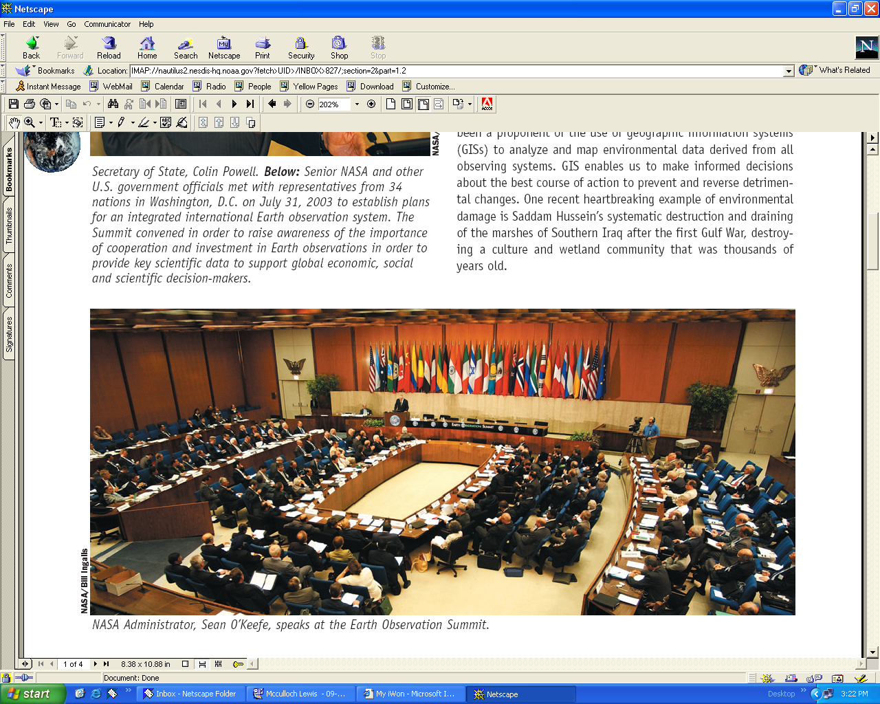
GEO, the Group on Earth Observations
An Intergovernmental Body with 87 Members and
61 Participating Organizations
U.S. Department of State, Washington DC
July 31, 2003

Slide 4
GEO
Group on Earth Observations
GEOSS
Global Earth Observation
System of Systems

Slide 5
GEOSS will provide the overall conceptual and organizational framework to build towards integrated global Earth observations to meet user needs. (10 Year Implementation Plan – Scope)

Slide 6
User communities include managers and policy makers in the targeted SBAs, scientific researchers and engineers, civil society, governmental and non-governmental organizations and international bodies, such as those assisting with the implementation of multilateral environmental agreements.
Engagement of users in developing countries
(10 Year Implementation Plan – User Involveement)

Slide 7
Coordination role to address the way user requirements are being met
Organize regular GEOSS User Fora, making use of user communities where they exist and catalyzing the formation of new ones where they do not
Create an appropriate mechanism for coordinating user requirements across societal benefit areas.
User Fora will document and review user requirements, assess the extent they are being met, and make recommendations
(10 Year Implementation Plan – User Involveement)

Slide 8
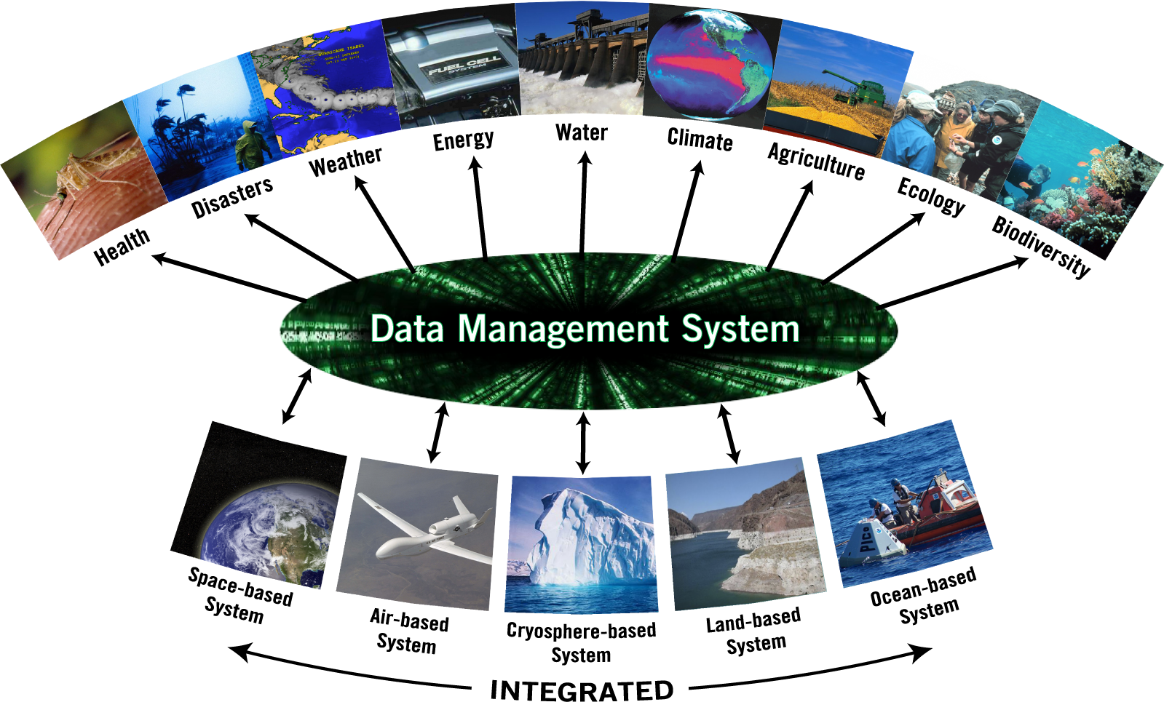
A Global, Coordinated, Comprehensive and Sustained System of Observing Systems
GEOSS
Notes:
GEOSS is a global distributed system, including satellite observation systems, Global in situ networks and systems, And local and regional in situ networks.
GEOSS will deliver the benefits of EO to both data & information providers and consumers world wide.

Slide 9
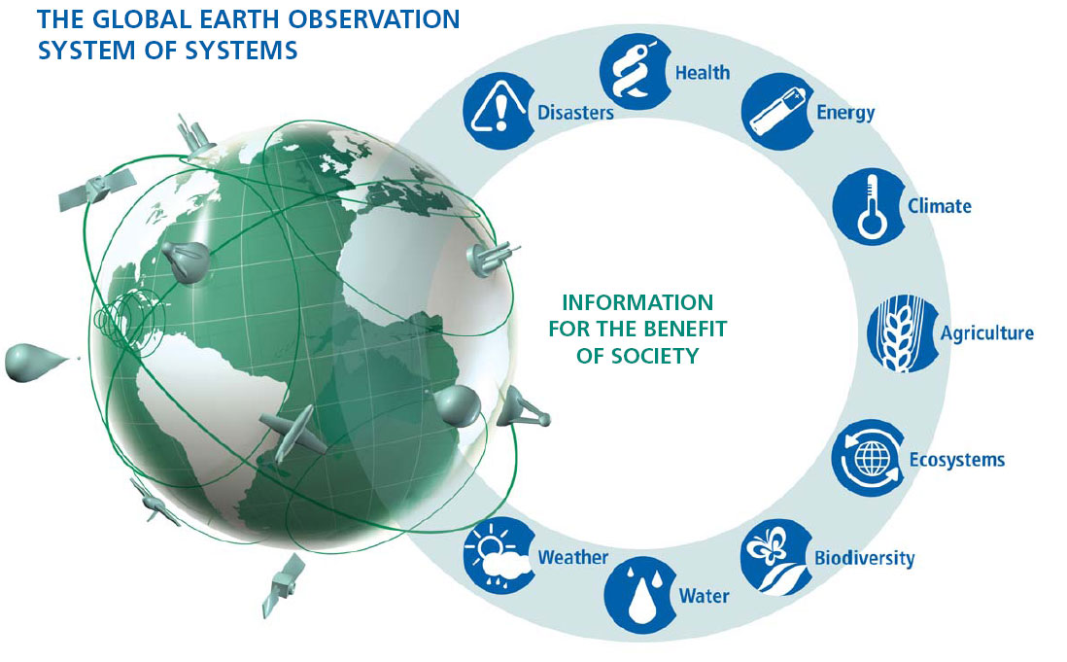

Slide 10
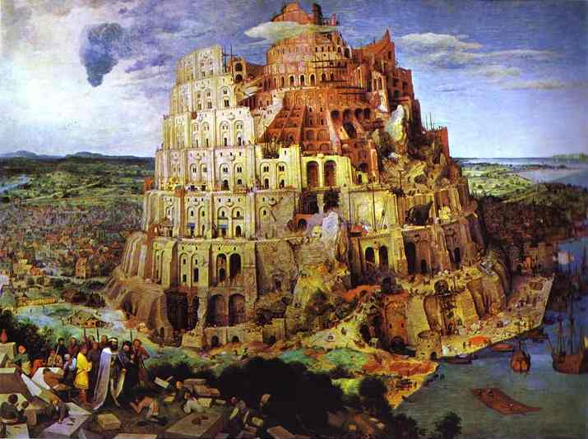
Tower of Babel Problem
There is a Need for a System which Provides Access to all Earth Observation Data in Standard Interoperable Formats
Need for a Portal and Clearinghouse
Access to all Earth Observation Data
Based on Existing Portals, Systems and Networks
Designed to Increase Quality and Accessibility of Information
Providing Decision Support Tools

Slide 11


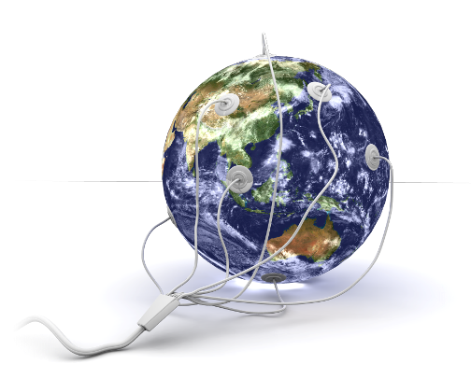
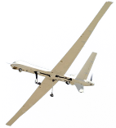


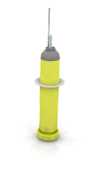
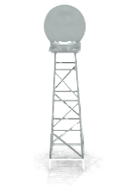
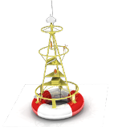
GEO Data Sharing Principles
Full and Open Exchange of Data, recognizing Relevant International Instruments and National Policies
Data and Products at Minimum Time delay and Minimum Cost
Free of Charge or minimal Cost for Research and Education
GEOSS Data-CORE
Notes:
See slide text

Slide 12
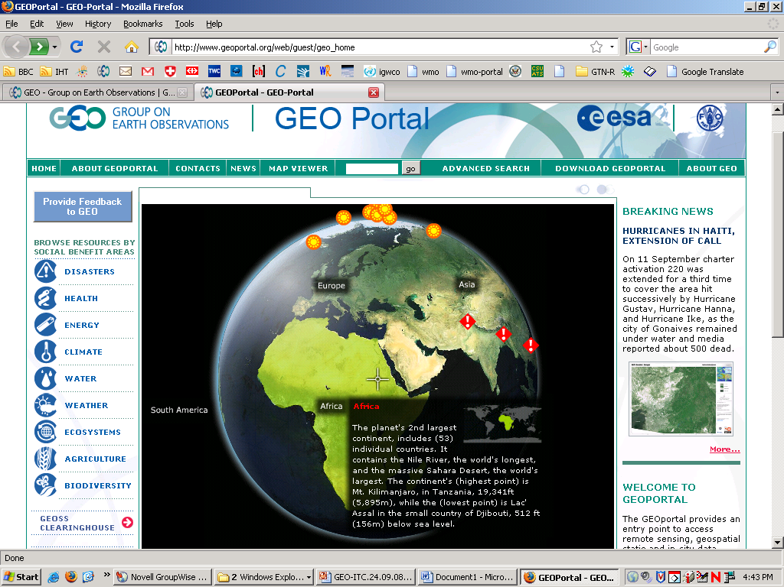
GEO Portal

Slide 13
GEOSS - Global Earth Observation System of Systems…
Coordinate and Sustain Observation Systems
Provide Easier & More Open Data Access
Foster Use through Science, Applications and Capacity Building
… to answer Society’s need for informed decision making
Notes:
Seven shortcoming were identified as target areas that GEOSS could address:
Lack of access to data and associated benefits in the developing world
Eroding technical infrastructure
Large spatial and temporal gaps in specific data sets
Inadequate data integration and interoperability
Uncertainty over continuity of observations
Inadequate user involvement
Lack of relevant processing systems to transform data into useful information

Slide 14
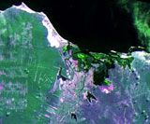
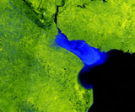
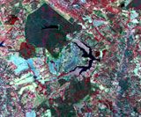
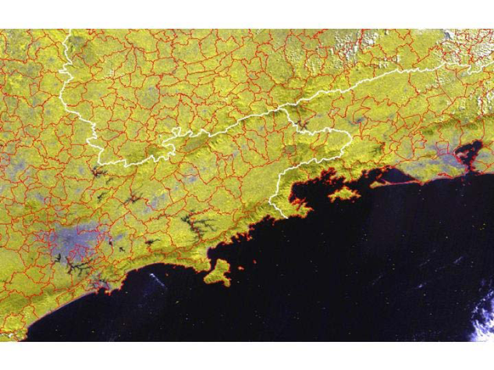
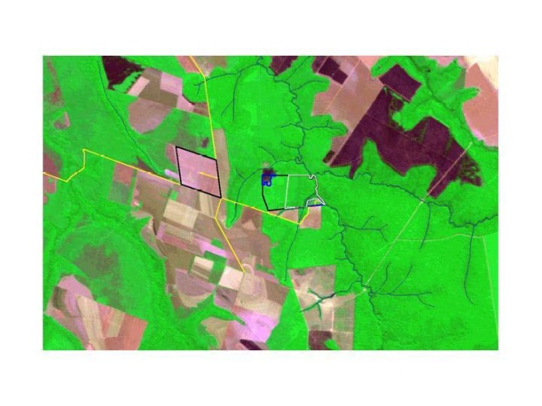
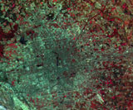
Applications and End-users
Agriculture and Forestry
Water resources Managers
Public Health Managers
Land Use Planners
Disasters (Floods, Spills)
Geological Mapping
Fisheries
Image source CBERS/INPE

Slide 15
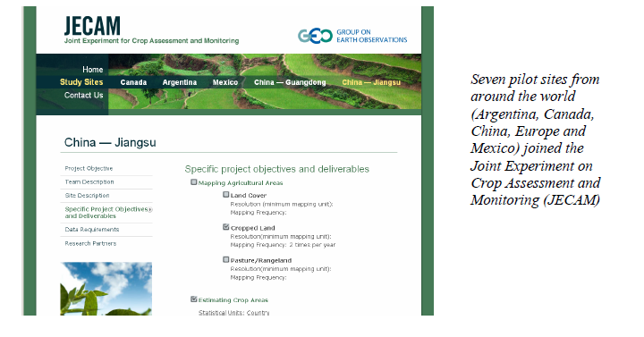
Crop Assessment and Monitoring

Slide 16
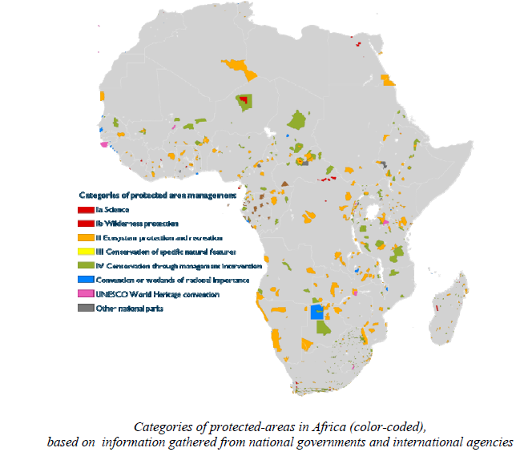
GEO Biodiversity Network

Slide 17
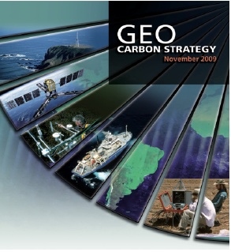
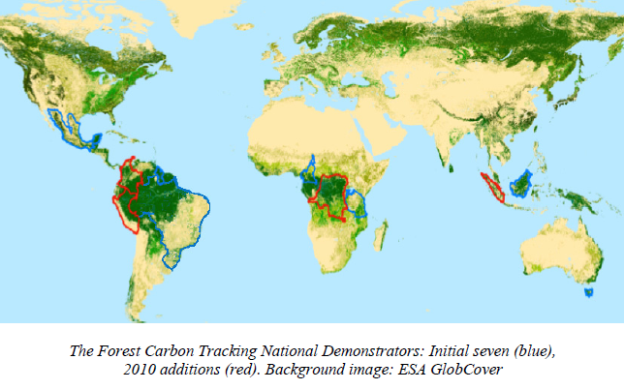
Carbon and Forest Carbon Tracking

Slide 18
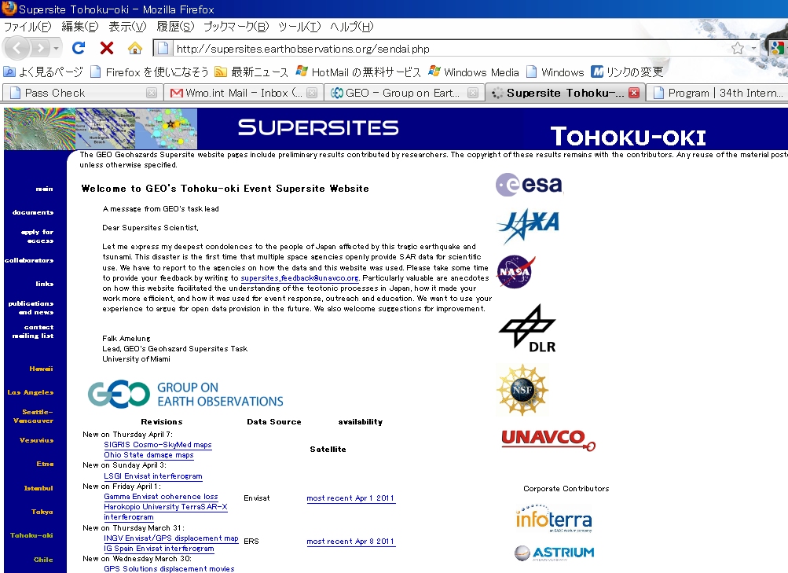
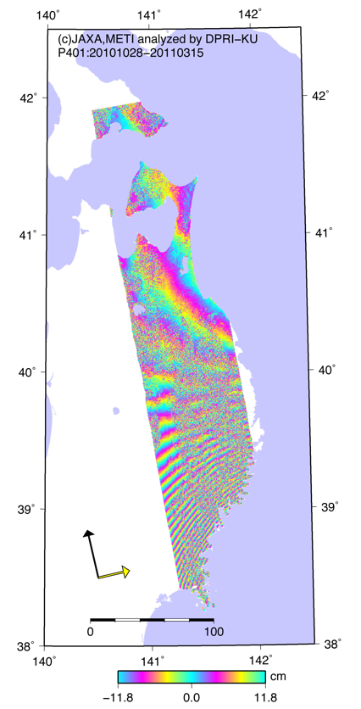

Slide 19
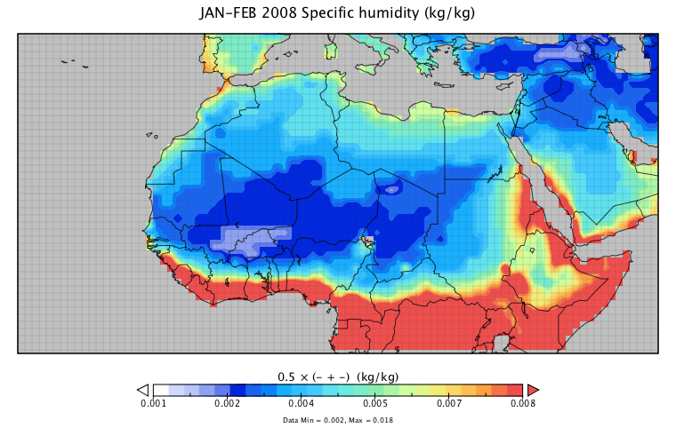
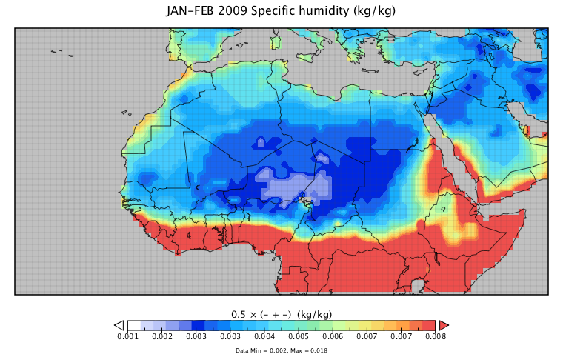
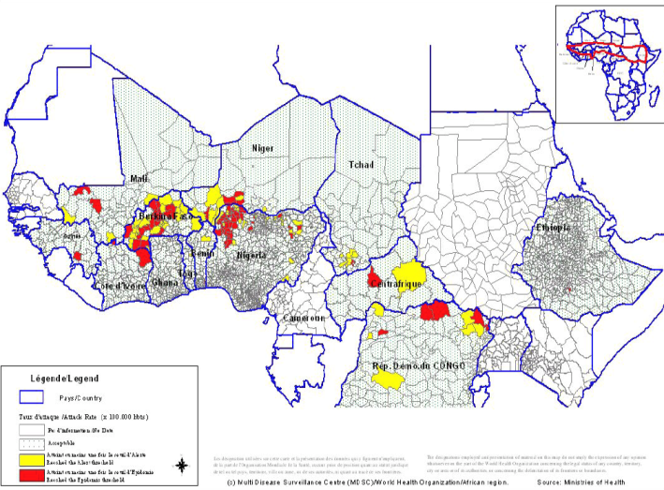
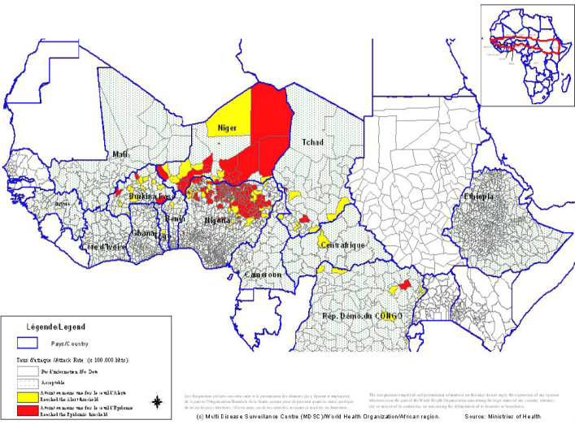
Meningitis Environmental Risk Information Technologies (MERIT)
NASA GLDAS dataset (Noah land surface model)
2008
2009
Recapitulative maps of cumulative Meningitis attack rates at weeks 1 – 39 (Mapping based on weekly highest attack rates by district during the year)
Notes:
Top: NASA GLDAS dataset indicating JAN-FEB 2008 Specific humidity
Lower: Recapitulative maps of cumulative Meningitis attack rates at weeks 1 – 39 (Mapping based on weekly highest attack rates by district during the year)
There is a strong correlation between humidity and meningitis outbreaks in the Sub-Saharan area.

Slide 20
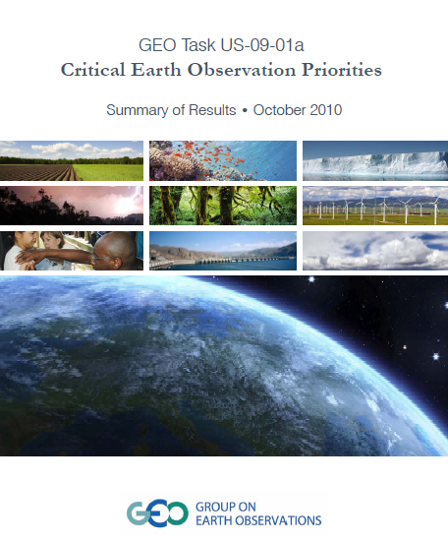
Identifying
Priority
Earth Observations
across many SBAs

Slide 21
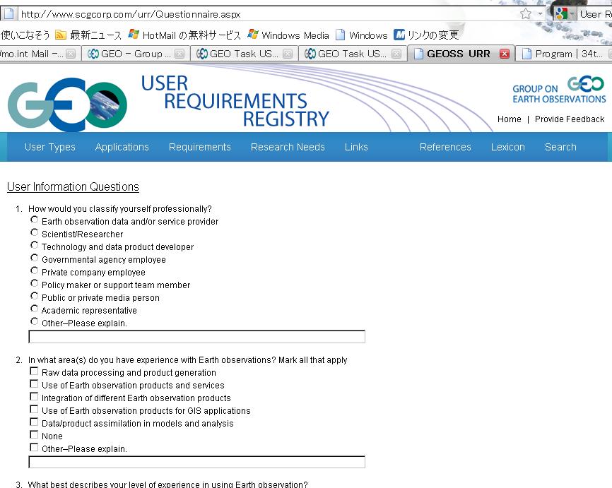
User Requirements Registry
URR is part of the GEOSS Registries allows users to publish their needs in terms of Earth information, and it enables users and providers to analyze the value chains from Earth observations to end users.
Notes:
The GEO User Requirements Registry (URR), which is part of the GEOSS Registries allows users to publish their needs in terms of Earth information, and it enables users and providers to analyze the value chains from Earth observations to end users. In order to collect and update information on user needs, GEO has established several processes to engage users depending directly or indirectly on Earth observations The URR is one of the principal user engagement mechanisms in GEOSS. The core of the URR is a comprehensive database with information on user types, applications, and requirements as well as their inter-connectivity. Population of the URR is based on peer contribution similar to the Wikipedia system. Moreover, relevant information from the reports produced by the GEO Work Plan Task US-09-01a has been extracted and entered into the URR. Engineers, scientists and policy makers world-wide who contributed the US-09-01a reports are being asked to assist in populating the URR. As far as possible, information is also harvested from other databases with information on user needs. But the biggest contribution will have to come from individual users who publish their needs.

Slide 22
The Concept of “Community of Practice”
Groups of people who share a concern, a set of problems, or a passion about a topic and deepen their knowledge by interacting on an ongoing basis
Bring together...
Users
Providers
Universities and research institutions
Technology development actors
Developed countries
Developing countries
Air Quality
Biodiversity
Carbon
Coastal Zone
Energy
Forest
Geohazards
Global Agriculture Monitoring
Health & Environment
Integrated Water Cycle Observation
Notes:
22

Slide 23

User Engagement at ISRSE
Workshop – Sunday, 10 April
Exhibition – GEO User Interface Committee
Sessions – TS-68 “Remote Sensing – Users, Priorities and Challenges” Thursday, 14 April
Notes:
See slide text

Slide 24
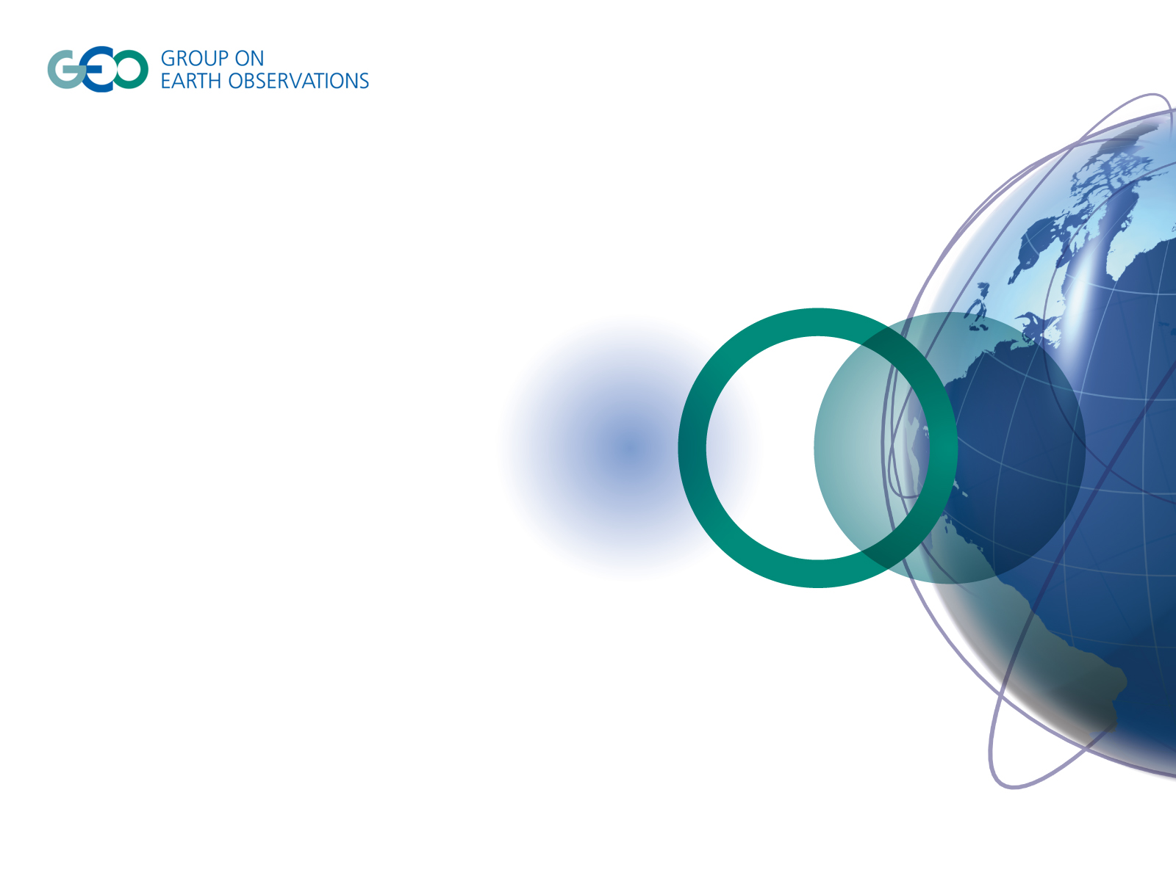
Thank you! www.earthobservations.org

