Slide 1
From “Usability Testing 2009” to the “Sprint to Plenary 2011”
GEO Portal and Clearinghouse: reaching out to users with user-friendly interfaces.
Gary J. Foley, PhD
Co-chair, User interface Committee
10 April 2011

Slide 2
GEOSS Starts and Ends with the Users i.e. the Decision-Makers
It starts with the engagement of a “spectrum” of relevant Users (decision-makers) to learn about what they do and what GEOSS could help them do it better
It ends with feedback from the Users on whether decision-making improved and the anticipated Societal Benefits were realized

Slide 3
THE SPECTRUM OF USERS
From observations systems
User requirements well known
Earth observations & earth system models
Data-to-Information archiving & services
Decision support tool development
Decision making
Assessment of benefits
Earth system scientists and modelers
Earth system service providers
Environmental process modelers & researchers
Policy Makers & Environmental managers
Public officials, advocacy groups & the Public
To societal benefits
Not aware that observational Requirements are even needed

Slide 4
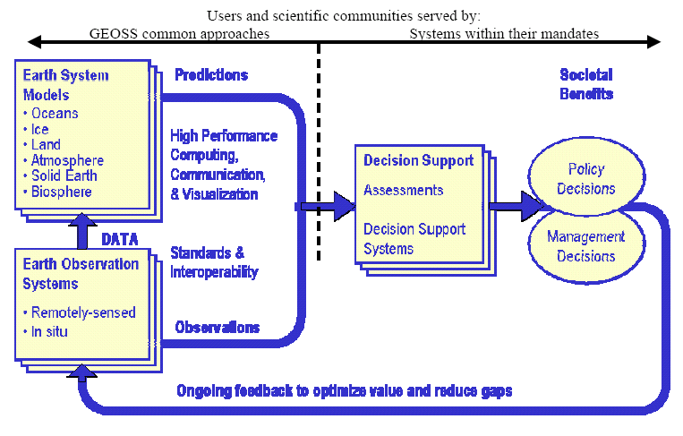
The GEOSS Framework 2005
Users and Scientific Communities Served By
GEOSS Common Approaches Systems within their Mandates
UIC Goal
Organize this side of the
GEOSS Architecture

Slide 5
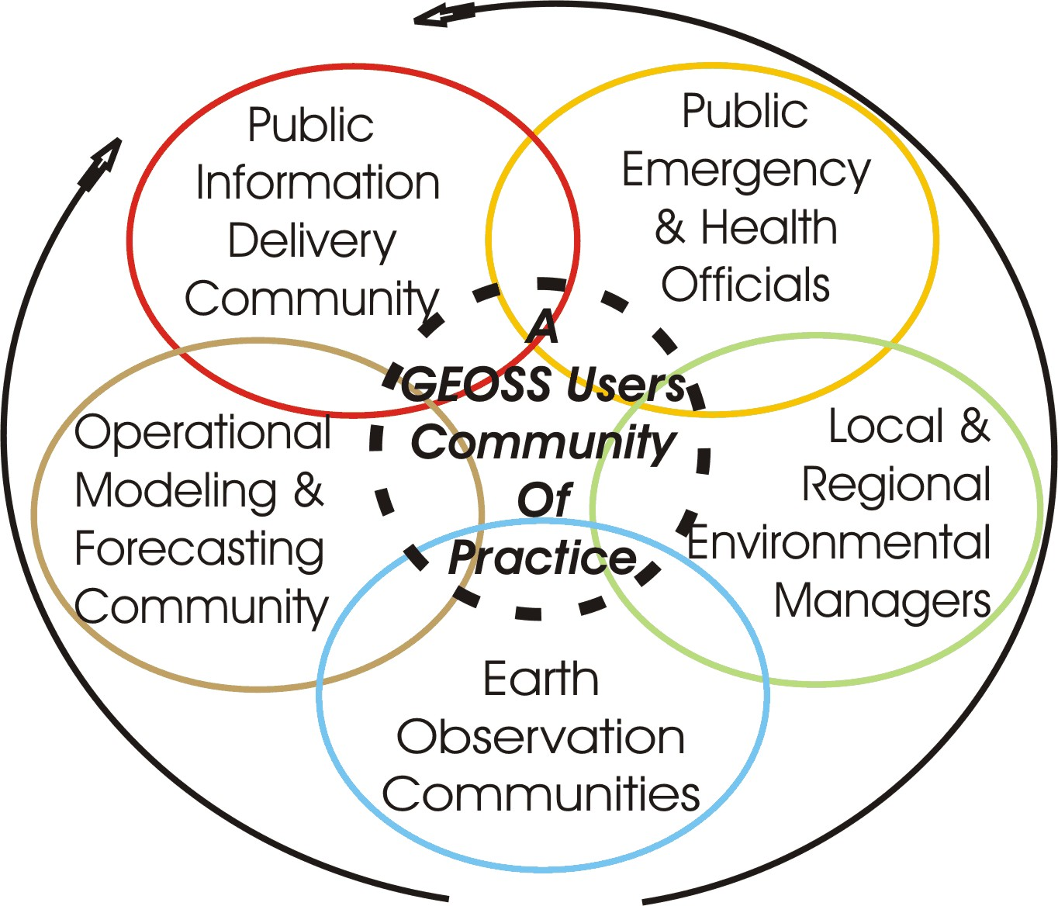
The Public
Public Officials
NGOs

Slide 6
Usability Testing and the GEOSS Common Infrastructure (GCI)
Almost no one was testing the three GEO Portals and the GCI
Usability testing was sponsored by the UIC at ISRSE-33, via webex, at GEO-VI, ESIP’s meeting and GEO WP Symposium
Almost 250 testers; good feedback
Reports to the IOC, the Portal Providers , the GCI-CT and the ADC with constructive feedback

Slide 7
THE SPECTRUM OF USERS
From observations
Requirements well known
Earth observations & earth system models
Data-to-Information archiving & services
Decision support tool development
Decision making
Assessment of benefits
Earth system scientists and modelers
Earth system service providers
Environmental process modelers & researchers
Policy Makers & Environmental managers
Public officials, advocacy groups and the Public
NOVICE USERS
To societal benefits
Not aware that observational Requirements are even needed

Slide 8
The “Novice” User
science-to-policy analysts, decision makers, public officials, & the public
working/interested in specific issues that fall within one or more SBAs
not often SOA- or GEOSS-experienced
looking for any and all observational data relevant to their issues
want to easily find it and view it

Slide 9
The “Novice” User
For the Novice User, in 2009 UIC believes
The GEOSS Common Infrastructure is not YET user friendly
Metadata is important, but not useful
Components (data/services) need to provide sample data sets for easy viewing geographically

Slide 10
Sprint to the Plenary 2011
Plenary-VI: The ADC realized that the feedback from the UIC was important
April 2011, UIC Meeting: The ADC presents a proposal to the UIC to partner in the Sprint to the Plenary

Slide 11
ADC Background and issues
ADC meeting in Brazil resolved to adopt a modified approach in demonstrating value of GEOSS to share with Plenary:
Evolve from search to EO data access*
Simplify registration, discovery, and access*
Enable/integrate access to key inventories
Focus on Critical EO Priorities and Data-CORE
* Responses to UIC feedback

Slide 12
Sprint to Plenary action plan
Develop a vocabulary of EO observational parameters(April 18 – core set; June 1 for all UIC-identified terms)
Identify, assess and prioritize data sets (triage) supporting priority EO parameters (April 15, 2011)
Engage data providers in enabling online access (April 15 – August 30, 2011)

Slide 13
Action plan, cont’d
Integrate selected features of FedEO, GENESI-DR, and EuroGEOSS into GCI (April 15 – Sept 30, 2011)
Complete GCI upgrades for the Plenary demonstration (May – September 2011)
Package demonstration and usability testing for Plenary (July – November 2011)

Slide 14
1. Develop a vocabulary of EO observational parameters
Identify observational parameters that support the UIC EO Priorities
Use/leverage existing vocabularies and definitions
Build navigation hierarchies/networks
UIC: Collaborate in evaluation of vocabulary in coordination with the User Requirements Registry lexicon

Slide 15
2. Identify, assess and prioritize data sets supporting priority EO parameters
Use GEOSS Data-CORE as a reference but engage all providers to locate data resources supporting the EO priorities
Set priority for engagement (Next subtask) based on 1) standard online access, 2) any online access, and 3) offline/order access.
UIC: Assist in identification of high priority data sets, from a user point of view

Slide 16
3. Engage data providers in enabling online access
Simplify registration process
Tag priority EO metadata with GEOSS Data-CORE and EO vocabulary
Assist in registration of highly-accessible priority EO data
Assist in enabling access to priority EO data using standard protocols

Slide 17
4. Evaluate integration of features of FedEO, GENESI-DR, and EuroGEOSS into GCI
Evaluate current capabilities and features
Demonstrate minimal integration of systems into GCI
Develop operational plan to more fully integrate elements into GCI by Plenary

Slide 18
5. Complete GCI upgrades for the Plenary demonstration
Modify GCI components to improve browse and search capabilities
Exploit EO vocabulary in browse
Deploy brokered search capability
Enable search for Data-CORE, EO Priorities, and image inventories through GCI (GWP+CH)
UIC: Assist in developing and running user scenarios that exercise browse, search, and access capabilities.

Slide 19
6. Package demonstration and usability testing for Plenary
Script demonstration of available and planned capabilities for the Plenary
Conduct demonstration for Plenary
Conduct another round of usability testing at Plenary
UIC: Primary role in developing and presenting the demonstration for Plenary

Slide 20
Summary of requested UIC assistance
Collaborate in evaluation of vocabulary in coordination with the User Requirements Registry lexicon
Assist in identification of high priority data sets, from a user point of view
Assist in developing and running user scenarios that exercise browse, search, and access capabilities
Primary role in developing and presenting the demonstration for Plenary

